Slide 1


Slide 2
Chapter 1
Communicating in the Technical Workplace

Slide 3
Chapter Outline
What is Technical Writing?
Developing a Workplace Writing Process
What Is Technical Communication?
How Important Is Technical Communication?

Slide 4
What is Technical Writing?
It is written communication for business, industry, and professional workplace to deliver information with the intent of achieving a desired purpose.
Communication
Sender
(Writer)
Receiver
(Reader)
Message
Written Text

Slide 5
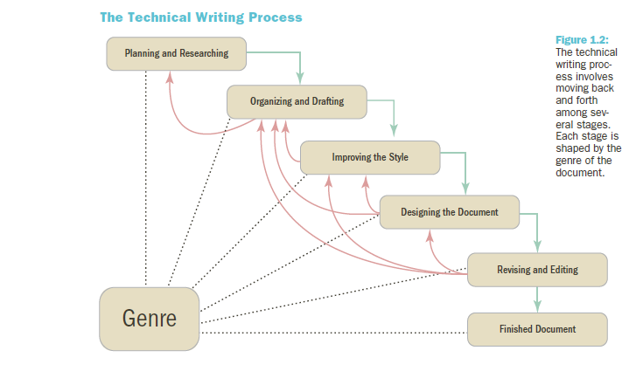
Developing a Workplace Writing Process

Slide 6
Developing a Workplace Writing Process
Technical Writing Is a Process That Includes the Following Stages:
Stage 1: Planning and Researching
Define the rhetorical situation
State your purpose
Research your subject
Notes:
Planning and Researching involves three activities:
Define the rhetorical situation (The five W and How questions give you a sense of your rhetorical situation.)
Four elements of the rhetorical situation:
Subject – what is document about? What is the scope of the project?
Purpose – what is the document trying to achieve? Why do the readers need it? What do they need to know?
Readers – who are the readers? What are their needs and interests? What are they looking for?
Context of Use – where and when will the document be used? What constraints are there?
2. State your purpose – what you want to do and what you want your document to achieve
Purpose statement will help guide decisions about document, focus writing.
Try to express exactly what you want your document to achieve using action verbs.
Research your subject – gather information from a variety of sources
Information management is key

Slide 7
Developing a Workplace Writing Process (cont.)
Define the rhetorical situation (The five W and How questions give you a sense of your rhetorical situation.)
Four elements of the rhetorical situation:
Subject – what is document about? What is the scope of the project?
Purpose – what is the document trying to achieve? Why do the readers need it? What do they need to know?
Readers – who are the readers? What are their needs and interests? What are they looking for?
Context of Use – where and when will the document be used? What constraints are there?
Notes:
Planning and Researching involves three activities:
Define the rhetorical situation (The five W and How questions give you a sense of your rhetorical situation.)
Four elements of the rhetorical situation:
Subject – what is document about? What is the scope of the project?
Purpose – what is the document trying to achieve? Why do the readers need it? What do they need to know?
Readers – who are the readers? What are their needs and interests? What are they looking for?
Context of Use – where and when will the document be used? What constraints are there?
2. State your purpose – what you want to do and what you want your document to achieve
Purpose statement will help guide decisions about document, focus writing.
Try to express exactly what you want your document to achieve using action verbs.
Research your subject – gather information from a variety of sources
Information management is key

Slide 8
Developing a Workplace Writing Process (cont.)
Technical Writing Is a Process That Includes the Following Stages (cont.):
Stage 2: Organizing and drafting the content
Organizing the content – use common genres
Drafting the content – include facts, data, reasoning, and examples
Notes:
Organizing and drafting
Organizing the content – use common genres
Drafting the content – include facts, data, reasoning, and examples
Improving the style
Plain style – stresses clarity and accuracy
Persuasive style – aims to motivate readers by appealing to their values and emotions
Similes and analogies add a visual quality to work
Metaphors change readers perspective
Changes in tone and pace add energy and color
Most workplace texts are written in plain style.
Goal should always be clear and concrete writing.

Slide 9
Developing a Workplace Writing Process (cont.)
Technical Writing Is a Process That Includes the Following Stages (cont.):
Stage 3: Improving the style
Plain style and persuasive style
Notes:
Organizing and drafting
Organizing the content – use common genres
Drafting the content – include facts, data, reasoning, and examples
Improving the style
Plain style – stresses clarity and accuracy
Persuasive style – aims to motivate readers by appealing to their values and emotions
Similes and analogies add a visual quality to work
Metaphors change readers perspective
Changes in tone and pace add energy and color
Most workplace texts are written in plain style.
Goal should always be clear and concrete writing.

Slide 10
Developing a Workplace Writing Process (cont.)
Technical Writing Is a Process That Includes the Following Stages (cont.):
Stage 4: Designing the Document
Stage 5: Revising and Editing
Level 1: Revising
Level 2: Substantive editing
Level 3: Copyediting
Level 4: Proofreading
Notes:
Designing the document – only takes minutes with a computer
Readers expect good design
Readers are “raiders” for information.
Readers want effective graphics and layout to make information more accessible, interesting, and attractive.
Design should make document attractive and easy to read.
Revising and Editing
Level 1: Revising – re-examine subject and purpose. What information do readers need to know?
Level 2: Substantive editing – look closely at content, organization, and design. Can readers find information they need?
Level 3: Copyediting – are sentences, paragraphs, and graphics clear, accurate, and efficient?
Level 4: Proofreading – eliminate grammar errors, typos, spelling errors, and usage mistakes. Errors indicate low-quality work.

Slide 11
Genres and the Technical Writing Process
Genres
Relatively stable patterns that reflect the activities and practices of the workplace
Shape a document’s content, organization, style, design, and medium
Help you anticipate the needs of your readers and their situations
Notes:
Genre Example – Technical specifications vs. analytical reports
different kinds of information
different workplace situations
different organizational patterns
different style and design
Genres do more than help you organize your ideas
They help you interpret complex work situations
Genres reflect the activities and practices of scientific and technical workplaces.
Each genre should be adapted to fit the readers and situations.

Slide 12
Which of the following is true of genres?
They change frequently.
They depend on the writer’s needs.
They reflect activities and practices of organizations.
All of the above

Slide 13
Which of the following is true of genres?
They change frequently.
They depend on the writer’s needs.
They reflect activities and practices of organizations.
All of the above

Slide 14
What Is Technical Communication?
Technical Communication
A process of managing technical information in ways that allow people to take action
Interactive and adaptable
Reader-centered
Notes:
Technical communication is the process of managing technical information in ways that allow people to take action.
Key words: process, manage, action
It is important to manage flow of information so you can get things done.
Technical communication is interactive and adaptable.
Computers = interactivity and collaboration.
Computers create environment where people are constantly communicating.
It is possible to quickly adapt documents and presentations to fit needs of readers and situations.
Websites are interactive forms of technical communication.
Technical communication is reader-centered.
Goal is not to express your ideas and opinions as writer.
Technical communication concentrates on what readers “need to know” to take action.
Technical communication tends to be highly pragmatic.
It needs to be efficient, easy to understand, accessible, action oriented, and adaptable.
Technical workplaces are highly collaborative. Teams of specialists often work together.

Slide 15
What Is Technical Communication? (cont.)
Technical Communication
Relies on teamwork
Is visual
Has ethical, legal, and political dimensions
Is international and cross-cultural
Notes:
Technical communication relies on teamwork.
Technical workplaces are highly collaborative. Teams of specialists often work together.
Writing and presenting with a team are crucial skills.
With connections through email and internet, many people may work on a single document simultaneously.
Technical communication is visual.
Visual cues help readers quickly locate information. Headings, lists, diagrams, marginal notes are common in technical documents.
Charts, graphs, drawings, and pictures can clarify and strengthen arguments. Readers grow impatient with large blocks of text.
Technical communication has ethical, legal, and political dimensions.
Be aware of ethical, legal, and political issues in the workplace. Computers create new concerns.
The trend is toward more employee decision making and accountability with fewer checks and balances.
Technical communication is international and cross-cultural.
Computers have increased international nature of technical workplace. Almost all companies and institutions compete in a global marketplace.
You will work with employees who speak other languages and have different customs. They may also have different expectations about technical documents and presentations.

Slide 16
Which statement about technical communication is true?
It allows the writer to express his or her ideas and opinions.
Computers have eliminated many aspects of teamwork in the creation of technical documents.
Large blocks of text provide the readers with the information that they need.
Documents can be adapted to meet the needs of their readers.

Slide 17
Which statement about technical communication is true?
It allows the writer to express his or her ideas and opinions.
Computers have eliminated many aspects of teamwork in the creation of technical documents.
Large blocks of text provide the readers with the information that they need.
Documents can be adapted to meet the needs of their readers.

Slide 18
How Important Is Technical Communication?
Oral and Written Communication Skills Are among the Most Important in the Technical Workplace.
40% of Employers Wanted New Hires to Have Better Speaking Skills; 25% Wanted New Hires to Have Better Writing Skills (Stevens, 2005).
Notes:
Areas of needed improvement in Survey about engineering education showed oral communication first, technical writing third.
Poor writing skills are the “kiss of death” in the workplace.
The ability to communicate effectively can be learned.
More than half of surveyed companies report considering writing skills in the hiring process for salaried employees.

Slide 19
Which of the following is true of communication skills?
They cannot be learned.
Many employers frequently or almost always take writing into consideration when hiring.
They are less important to employers in the engineering industry.
Most employers are satisfied with the communication skills of new employees.

Slide 20
Which of the following is true of communication skills?
They cannot be learned.
Many employers frequently or almost always take writing into consideration when hiring.
They are less important to employers in the engineering industry.
Most employers are satisfied with the communication skills of new employees.

